Slide 1
Digital Security and Forensics AICT006-4-2-DSF Version 2
Malicious Codes

Slide 2
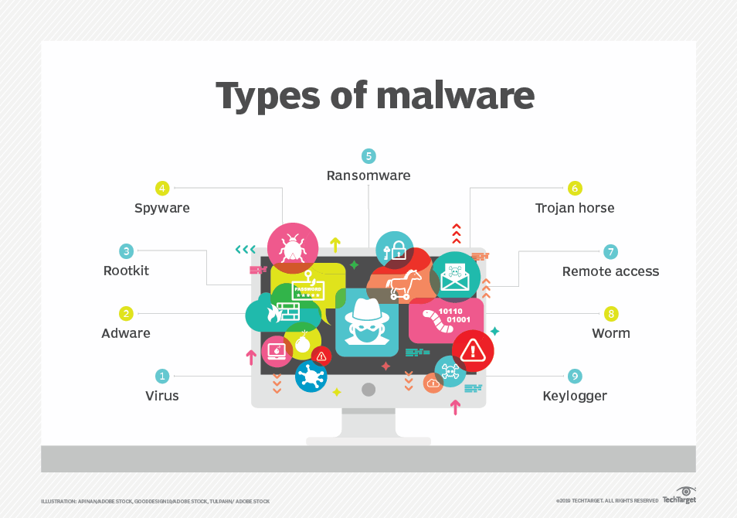
Malware
“A program that is inserted into a system, usually covertly, with the intent of compromising the confidentiality, integrity, or availability of the victim’s data, applications, or operating system or otherwise annoying or disrupting the victim.”

Slide 3
Malicious Software
Examines malicious software, with a special emphasis on viruses and worms then turn to bots and rootkits. Throughout, the discussion presents both threats and countermeasures.
Malicious software can be divided into two categories:
Need a host program - essentially fragments of programs that cannot exist independently of some actual application program, utility, or system program. Viruses, logic bombs, and backdoors are examples.
Independent - self-contained programs that can be scheduled and run by the operating system. Worms and bot programs are examples.
Differentiate between those software threats that do not replicate and those that do.
Fragment of programs or self-contained programs that are activated by a trigger. Examples are logic bombs, backdoors, and bot programs.
Fragment of programs or self-contained programs that, when executed, may produce one or more copies of itself to be activated later on the same system or some other system. Viruses and worms are examples.

Slide 4






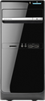

Malicious software
Programs exploiting system vulnerabilities
Known as malicious software or malware
program fragments that need a host program
e.g. viruses, logic bombs, and backdoors
independent self-contained programs
e.g. worms, bots
replicating or not
Sophisticated threat to computer systems

Slide 5
Malware Terminology
Virus: attaches itself to a program
Worm: propagates copies of itself to other computers
Logic bomb: “explodes” when a condition occurs
Trojan horse: fakes/contains additional functionality
Backdoor (trapdoor): allows unauthorized access to functionality
Mobile code: moves unchanged to heterogeneous platforms
Auto-rooter Kit (virus generator): malicious code (virus) generators
Spammer and flooder programs: large volume of unwanted “pkts”
Keyloggers: capture keystrokes
Rootkit: sophisticated hacker tools to gain root-level access
Zombie: software on infected computers that launch attack on others (aka bot)

Slide 6
Some terms
Payload: actions of the malware
Crimeware: kits for building malware; include propagation and payload mechanisms
Zeus, Sakura, Blackhole, Phoenix
APT (advanced persistent threats)
Advanced: sophisticated
Persistent: attack over an extended period of time
Threat: selected targets (capable, well-funded attackers)

Slide 7
Viruses
Piece of software that infects programs
modifying them to include a copy of the virus
so, it executes secretly when host program is run
Specific to operating system and hardware
taking advantage of their details and weaknesses
A typical virus goes through phases of:
Dormant phase: The virus is idle. The virus will eventually be activated by some event, such as a date, the presence of another program or file, or the capacity of the disk exceeding some limit. Not all viruses have this stage.
Propagation phase: The virus places an identical copy of itself into other programs or into certain system areas on the disk. Each infected program will now contain a clone of the virus, which will itself enter a propagation phase.
Triggering phase: The virus is activated to perform the function for which it was intended. As with the dormant phase, the triggering phase can be caused by a variety of system events, including a count of the number of times that this copy of the virus has made copies of itself.
Execution phase: The function is performed, which may be harmless, e.g., a message on the screen, or damaging, e.g., the destruction of programs and data files

Slide 8
Virus Structure
A computer virus has three parts:
Infection mechanism: The means by which a virus spreads, enabling it to replicate. The mechanism is also referred to as the infection vector.
Trigger: event or condition determining when the payload is activated or delivered.
Payload: What the virus does, besides spreading. The payload may involve damage or may involve benign but noticeable activity.
A virus can be prepended or postpended to an executable program, or it can be embedded in some other fashion. The key to its operation is that the infected program, when invoked, will first execute the virus code and then execute the original code of the program.
Once a virus has gained entry to a system by infecting a single program, it is in a position to infect some or all other executable files on that system when the infected program executes.
Viral infection can be completely prevented by preventing the virus from gaining entry in the first place. Unfortunately, prevention is extraordinarily difficult because a virus can be part of any program outside a system.
The lack of access controls on early PCs is a key reason why traditional machine code-based viruses spread rapidly on these systems. In contrast, while it is easy enough to write a machine code virus for UNIX systems, they were almost never seen in practice due to the existence of access controls on these systems prevented effective propagation of the virus.

Slide 9
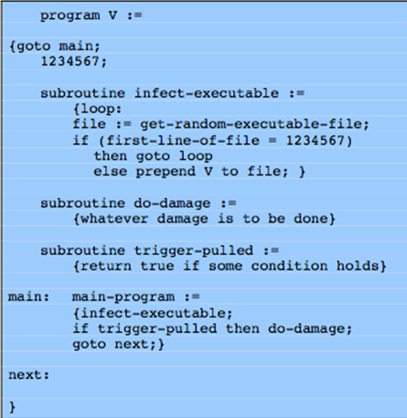
Virus structure
In this case, the virus code, V, is pretended to infected programs, and it is assumed that the entry point to the program, when invoked, is the first line of the program. An infected program begins with the virus code and works as follows.
The first line of code is a jump to the main virus program.
The second line is a special marker that is used by the virus to determine whether or not a potential victim program has already been infected with this virus. When the program is invoked, control is immediately transferred to the main virus program.
The virus program first seeks out uninfected executable files and infects them. Next, the virus may perform some action, usually detrimental to the system. This action could be performed every time the program is invoked, or it could be a logic bomb that triggers only under certain conditions.
Finally, the virus transfers control to the original program. If the infection phase of the program is reasonably rapid, a user is unlikely to notice any difference between the execution of an infected and uninfected program.

Slide 10
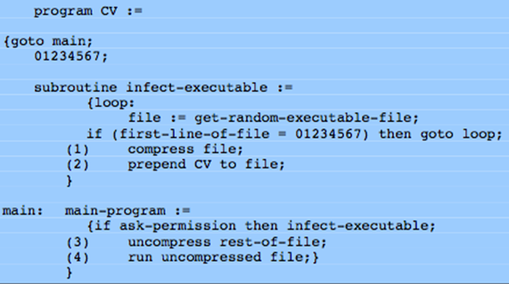
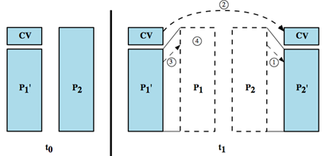
Compression virus
A virus such as the one just described is easily detected because an infected version of a program is longer than the corresponding uninfected one.
A way to thwart such a simple means of detecting a virus is to compress the executable file so that both the infected and uninfected versions are of identical length.
The key lines in this virus are numbered. In this example, the virus does nothing other than propagate. As in the previous example, the virus may include a logic bomb. We assume that program P1 is infected with the virus CV. When this program is invoked, control passes to its virus, which performs the following steps:
For each uninfected file P2 that is found, the virus first compresses that file to produce, which is shorter than the original program by the size of the virus.
A copy of the virus is prepended to the compressed program.
The compressed version of the original infected program is uncompressed.
The uncompressed original program is executed.
P1 is infected
Notes:
A

Slide 11
Virus classification
There has been a continuous arms race between virus writers and writers of antivirus software since viruses first appeared. As effective countermeasures have been developed for existing types of viruses, new types have been developed.
A virus classification by target includes the following categories:
Boot sector infector: Infects a master boot record or boot record and spreads when a system is booted from the disk containing the virus.
File infector: Infects files that the operating system or shell considers to be executable.
Macro virus: Infects files with macro code that is interpreted by an application.
A virus classification by concealment strategy includes the following categories:
Encrypted virus: the virus creates a random encryption key, stored with the virus, and encrypts the remainder of the virus. When an infected program is invoked, the virus uses the stored random key to decrypt the virus. When the virus replicates, a different random key is selected.
Stealth virus: A form of virus explicitly designed to hide from detection by antivirus software. Thus, the entire virus, not just a payload is hidden.
Polymorphic virus: A virus that mutates with every infection, making detection by the “signature” of the virus impossible.
Metamorphic virus: As with a polymorphic virus, a metamorphic virus mutates with every infection. The difference is that a metamorphic virus rewrites itself completely at each iteration, increasing the difficulty of detection. Metamorphic viruses may change their behavior as well as their appearance.

Slide 12
Macro and scripting viruses
In the mid-1990s, macro viruses became by far the most prevalent type of virus. Macro viruses are particularly threatening for a number of reasons:
A macro virus is platform independent. Virtually all of the macro viruses infect Microsoft Word documents. Any hardware platform and operating system that supports Word can be infected.
Macro viruses infect documents, not executable portions of code. Most of the information introduced onto a computer system is in the form of a document rather than a program.
Macro viruses are easily spread. A very common method is electronic mail.
Macro viruses take advantage of a feature found in Word and other office applications such as Microsoft Excel, namely the macro. In essence, a macro is an executable program embedded in a word processing document or other types of file.
For example, Microsoft offers an optional Macro Virus Protection tool that detects suspicious Word files and alerts the customer to the potential risk of opening a file with macros. Various antivirus (A/V) product vendors have also developed tools to detect and correct macro viruses. As in other types of viruses, the arms race continues in the field of macro viruses, but they no longer are the predominant virus threat.

Slide 13

E-Mail Viruses
More recent development
Melissa
exploits MS Word macro in attached doc
if attachment opened, macro activates
sends email to all on users address list and does local damage

Slide 14
Virus countermeasures
Prevention: ideal solution but difficult
Realistically need:
detection: determine what occurred
identification: identify the specific virus
removal: remove all traces
If detected but can’t identify or remove, must discard and replace infected program

Slide 15
Anti-virus evolution
Virus & antivirus tech have both evolved
Early viruses simple code, easily removed
As viruses become more complex, so did the countermeasures
Generations
A first-generation scanner requires a virus signature to identify a virus. The virus may contain "wildcards" but has essentially the same structure and bit pattern in all copies. Such signature-specific scanners are limited to the detection of known viruses.
A second-generation scanner uses heuristic rules to search for probable virus infection, e.g., to look for fragments of code that are often associated with viruses.. Another second-generation approach is integrity checking, using a hash function rather than a simpler checksum.
Third-generation programs are memory-resident programs that identify a virus by its actions rather than structure in an infected program. These have the advantage that it is not necessary to develop signatures/heuristics, but only to identify the small set of actions indicating an infection is attempted and then intervene.
Fourth-generation products are packages consisting of a variety of antivirus techniques used in conjunction. These include scanning and activity trap components. In addition, such a package includes access control capability, which limits the ability of viruses to penetrate a system and then limits the ability of a virus to update files in order to pass on the infection.

Slide 16
Generic Decryption (GD)
Runs executable files through GD scanner:
CPU emulator to interpret instructions
virus scanner to check known virus signatures
emulation control module to manage process
Lets virus decrypt itself in interpreter
Periodically scan for virus signatures
Let virus do the work for an antivirus program by exposing it in a controlled environment

Slide 17
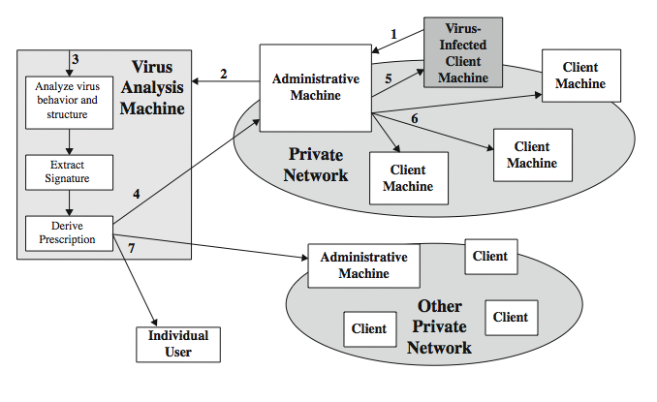
Digital Immune System
The digital immune system is a comprehensive approach to virus protection developed by IBM and subsequently refined by Symantec.
The objective of this system is to provide rapid response time so that viruses can be stamped out almost as soon as they are introduced.
When a new virus enters an organization, the immune system automatically captures it, analyzes it, adds detection and shielding for it, removes it, and passes information about that virus to other systems so that it can be detected before it is allowed to run elsewhere
A monitoring pgm infers a virus, sends a copy to an adm machine
Adm encrypts, sends to a central analysis machine
Central analysis: Safe exec of virus, analyze, give a prescription
Prescription sent back to the adm machines
Adm machine forwards to all clients
Prescription forwarded to other organizations
Subscribers worldwide receive regular updates IBM/Symantec Project

Slide 18
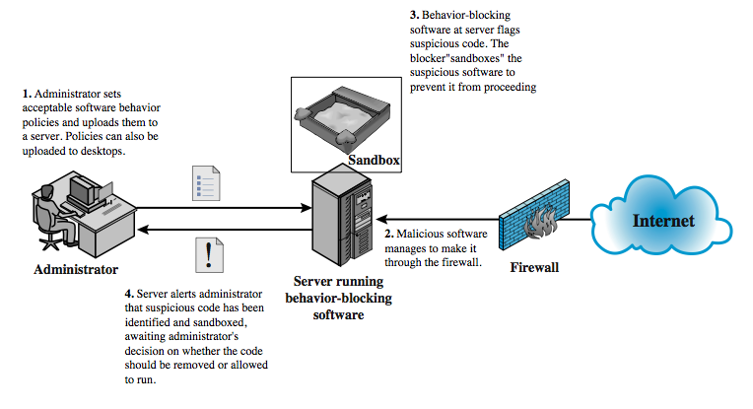
Behavior-blocking software
Behavior-blocking software integrates with the operating system of a host computer and monitors program behavior in real-time for malicious actions. The behavior blocking software then blocks potentially malicious actions before they can affect the system.
Monitored behaviors:
Attempts to open, view, delete, modify files
Attempts to format drives
Modifications to the logic of executables
Modifications to critical system settings
Scripting of emails to send exec contents

Slide 19
Worms
Replicating program that propagates over net
using email, remote exec, remote login
Has phases like a virus:
dormant, propagation, triggering, execution
propagation phase: searches for other systems, connects to it, copies self to it and runs
May disguise itself as a system process
Concept seen in Brunner’s “Shockwave Rider”
Implemented by Xerox Palo Alto labs in 1980’s

Slide 20
Morris worm
One of best know worms, released by Robert Morris in 1988
Affected 6,000 computers; cost $10-$100 M
According to Morris, the purpose of the worm was to gauge the size of the precursor “Internet” of the time - ARPANET - although it unintentionally caused denial-of-service (DoS) for around 10% of the 60,000 machines connected to ARPANET in 1988.
Various attacks on UNIX systems
cracking password file to use login/password to login to other systems
exploiting a bug in the finger protocol
exploiting a bug in sendmail
If succeed have remote shell access
sent bootstrap program to copy worm over

Slide 21
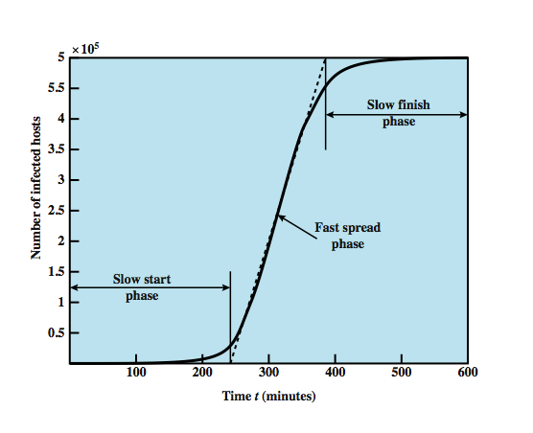
Worm Propagation Model
A model for worm propagation based on an analysis of recent worm attacks. The speed of propagation and the total number of hosts infected depend on a number of factors, including the mode of propagation, the vulnerability or vulnerabilities exploited, and the degree of similarity to preceding attacks.
Graph shows the dynamics for one, typical, set of parameters. Propagation proceeds through three phases.
In the initial phase, the number of hosts increases exponentially. To see that this is so, consider a simplified case in which a worm is launched from a single host and infects two nearby hosts. Each of these hosts infects two more hosts, and so on.
This results in exponential growth. After a time, infecting hosts waste some time attacking already-infected hosts, which reduces the rate of infection.
During this middle phase, growth is approximately linear, but the rate of infection is rapid. When most vulnerable computers have been infected, the attack enters a slow finish phase as the worm seeks out those remaining hosts that are difficult to identify.
Clearly, the objective in countering a worm is to catch the worm in its slow start phase, at a time when few hosts have been infected.
linear rate of infection
exponential rate of infection

Slide 22
Worm Propagation Model
linear rate of infection
exponential rate of infection

Slide 23
More recent worm attacks
Code Red
July 2001 exploiting MS IIS bug
probes random IP address, does DDoS attack
consumes significant net capacity when active
360,000 servers in 14 hours
Code Red II variant includes backdoor: hacker controls the worm
SQL Slammer (exploited buffer-overflow vulnerability)
early 2003, attacks MS SQL Server
compact and very rapid spread
Mydoom (100 M infected messages in 36 hours)
mass-mailing e-mail worm that appeared in 2004
installed remote access backdoor in infected systems

Slide 24
State of worm technology
Multiplatform: not limited to Windows
Multi-exploit: Web servers, emails, file sharing …
Ultrafast spreading: do a scan to find vulnerable hosts
Polymorphic: each copy has a new code
Metamorphic: change appearance/behavior
Transport vehicles (e.g., for DDoS)
Zero-day exploit of unknown vulnerability (to achieve max surprise/distribution)

Slide 25
Worm countermeasures
Overlaps with anti-virus techniques
Once worm on system Antivirus software can detect
Worms also cause significant net activity
Worm defense approaches include:
signature-based worm scan filtering: define signatures
filter-based worm containment (focus on contents)
payload-classification-based worm containment (examine packets for anomalies)
threshold random walk scan detection (limit the rate of scan-like traffic)
rate limiting and rate halting (limit outgoing traffic when a threshold is met)

Slide 26
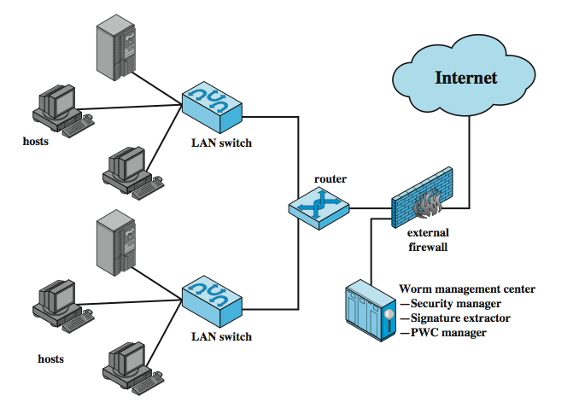
Proactive worm containment
PWC agent monitors
outgoing traffic for
increased activity
2. When an agent notices
high traffic, it informs
the PWC manager; mgr
propagates to other
hosts
3. Hosts receive alert
and decide if to ignore
(based on time of last
incoming pkt)
4. Relaxation period
(based on threshold)
The Proactive Worm Containment (PWC) scheme is host-based software that looks for surges in the rate of frequency of outgoing connection attempts and the diversity of connections to remote hosts. When such a surge is detected, the software immediately blocks its host from further connection attempts. A deployed PWC system consists of a PWC manager and PWC agents in hosts.

Slide 27
Mobile code
Scripts, macros or other portable instructions
Popular ones: JavaScript, ActiveX, VBScript
Heterogeneous platforms
From a remote system to a local system
Can act as an agent for viruses, works, and Trojan horses
Mobile phone works: communicate the Bluetooth connections (e.g., CommWarrior on Symbian but attempts on Android and iPhone)

Slide 28
Client-side vulnerabilities
Drive-by-downloads: common in recent attacks
Exploits browser vulnerabilities (when a user visits a website controlled by the attacker or a compromised website)
Clickjacking

Slide 29
Social engineering, spam, email, Trojans
Spam (much better protection now)
Trojan horse: looks like a useful tool but contains hidden code

Slide 30
Payload
Data destruction, theft
Data encryption (ransomware)
Real-world damage
Stuxnet: caused physical damage also (targeted to Siemens industrial control software)
Logic bomb

Slide 31
Payload attack agents: bots (zombie/drone)
Program taking over other computers and launch attacks
hard to trace attacks
If coordinated form a botnet
Characteristics:
remote control facility (distinguishing factor)
via IRC/HTTP etc
spreading mechanism
attack software, vulnerability, scanning strategy
Various counter-measures applicable (IDS, honeypots, …)

Slide 32
Uses of bots
DDoS
Spamming
Sniffing traffic
Keylogging
Spreading malware
Installing advertisement
Manipulating games and polls

Slide 33
Payload: information theft
Credential theft, key loggers, spyware
Phishing identify theft
Spear phishing (act as a trusted source for a specific target)

Slide 34
Payload: rootkits and backdoor
Set of programs installed for admin access
Malicious and stealthy changes to host O/S
May hide its existence
subverting report mechanisms on processes, files, registry entries etc
May be persistent (survives reboot) or memory-based
Do not rely on vulnerabilities
installed via Trojan
installed via hackers
Backdoor: often by programmers

Slide 35
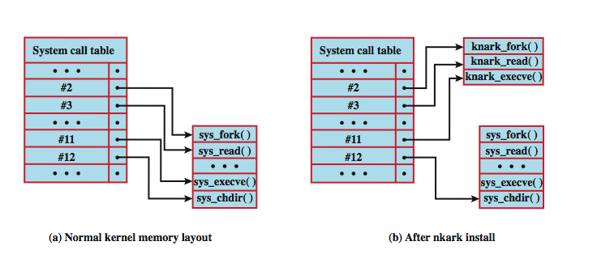
Rootkit System Table Mods A Unix Example
User API calls refer to a number; the system
maintains a system call table with one entry per number;
each number is used to index to a corresponding system routine
rootkit modifies the table and the calls go to the hackers
replacements

Slide 36
Countermeasures
Prevention
Detection, identification, removal
Requirement
generality
Timeliness
Resiliency
Minimal DoS costs
Transparency
Global/local coverage (inside and outside attackers)

Slide 37
Summary
introduced types of malicous software
incl backdoor, logic bomb, trojan horse, mobile
virus types and countermeasures
worm types and countermeasures
bots
rootkits
Notes:
Chapter 7 summary.

Slide 38
Q & A

Slide 39
What we cover next
Social Engineering, Physical, and Password Attacks

Slide 40
Thank You

